Slide 1
COGS 138 Week 5 Discussion Section
29th April 2024
Slides can be found on - https://github.com/n2mittal/COGS138-Sp24

Slide 2
Upcoming Deadlines
Assignment 2 due today – 29th April
Quiz 3 due Friday – 03rd May
Project proposal due next Monday – 06th May

Slide 3
Variability in Neuroimaging Analysis
A Study on Analytical Flexibility in fMRI
Notes:
Reading 3 is about a landmark study published in Nature in 2020 that investigated the variability in analysis outcomes when the same neuroimaging dataset is analyzed by many different teams using their own methods and workflows. The study aimed to assess the impact of analytical flexibility on scientific conclusions drawn from fMRI data.

Slide 4
Overview
70 independent teams analyzed the same fMRI dataset
Tested 9 pre-defined hypotheses about brain activity
Teams used different analysis pipelines/methods
Evaluated variability in reported results across teams
Notes:
The core of the study involved 70 independent research teams analyzing the same fMRI dataset collected to study decision-making under risk. Each team was asked to test 9 pre-specified hypotheses about brain activity related to the task. Importantly, the teams were free to use their own analysis pipelines and methods, mimicking the diversity seen in real-world neuroimaging research. This allowed the researchers to evaluate the variability in the reported results across teams due to differences in analytical approaches.

Slide 5
Results - Reported Findings
Substantial variability in reported significant findings
For 5 of 9 hypotheses, 21-37% of teams reported significance
Only 1 hypothesis had high consensus (84% significant)
On average, 20% of teams diverged from majority
Notes:
The study found substantial variability in the reported significant findings across teams for the same hypotheses. For 5 out of the 9 hypotheses, between 21-37% of teams reported a statistically significant result, indicating a lack of consensus. Only one hypothesis had a high degree of agreement, with 84% of teams reporting a significant finding. On average, 20% of teams reported a result that diverged from the majority, highlighting the impact of analytical choices on outcomes.

Slide 6
Results - Factors Contributing to Variability
Spatial smoothness of statistical maps
Choice of analysis software (e.g., FSL vs SPM)
Method of multiple testing correction
Potential model misspecification errors
Notes:
The study identified several factors that contributed to the variability in reported results across teams. Higher spatial smoothness of the statistical maps was associated with a greater likelihood of significant findings. The choice of analysis software package, such as FSL or SPM, also impacted outcomes, with FSL being linked to more significant results. Additionally, the method used for correcting for multiple comparisons influenced results, with parametric methods leading to higher detection rates than nonparametric methods. Finally, the researchers identified potential model misspecification errors in some teams' analyses, which led to statistical maps that were anticorrelated with the majority.

Slide 7
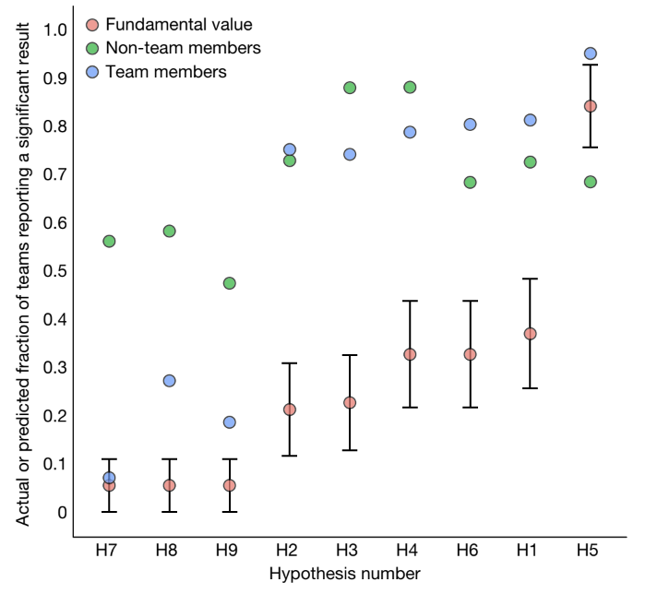
Prediction Markets
Researchers traded on outcomes (fraction of significant results)
Both team members and non-team members overestimated
Team members' predictions more accurate than non-members
Overall optimism bias in the field

Slide 8
Conclusions and Recommendations
Analytical flexibility has substantial effects on conclusions
Share unthresholded maps, data, and code for reproducibility
Perform multiverse analyses using multiple pipelines
Validate pipelines using simulations and new data
Meta-analysis can provide consensus across teams

Slide 9
Closing Thoughts
Highlights the need for transparency and reproducibility
Neuroimaging research can provide reliable answers
Similar variability likely in other complex data domains
Community efforts crucial for self-assessment and improvement

